Slide 1
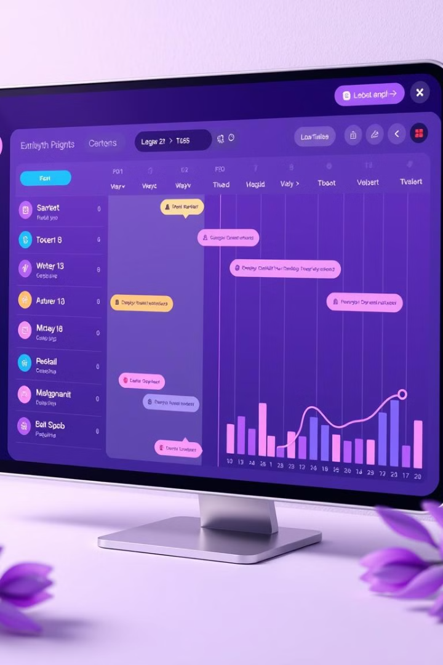
CPU Scheduler Visualizer (Tkinter GUI)
Visualize CPU scheduling algorithms using a user-friendly interface. Enjoy interactive Gantt charts, real-time animations, and performance metrics. This project is created using Python and Tkinter.

Slide 2

Problem: Understanding CPU Scheduling
Challenges in Understanding
Benefits of Visual Aids
CPU scheduling algorithms manage processes in operating systems.
Students and professionals benefit from visual aids. They provide an intuitive way to understand and compare algorithms.
Complex algorithms are hard to grasp theoretically.
Lack of interactive tools for visualization and comparison.

Slide 3
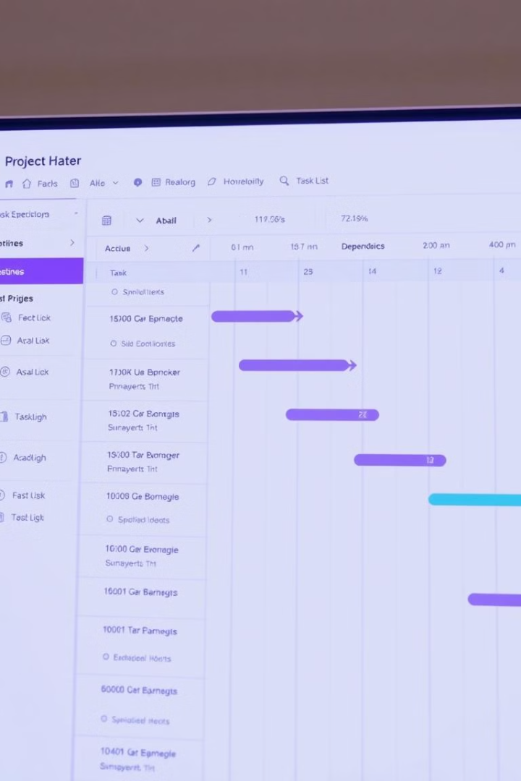
Solution: Tkinter-Based Visualizer
GUI Application
Simulate and visualize algorithms with a graphical user interface.
Dynamic Input
Adjust process parameters and inputs dynamically.
Gantt Chart
Represent scheduling with a clear Gantt chart.
Performance Metrics
Compare and analyze performance metrics.

Slide 4

Key Feature: Graphical Process Input
Intuitive Interface
Specify Details
Easy to add or modify processes with an intuitive interface.
Specify arrival time.
Specify burst time.
Specify priority (if applicable).
Real-Time Updates
See real-time updates to the Gantt chart as you input data.

Slide 5




Algorithms: FCFS and SJF
FCFS
First Come First Serve: Simple, non-preemptive algorithm.
SJF Non-Preemptive
Execute the shortest job to completion.
SJF Preemptive (SRTF)
Switch to the shorter job if it arrives.

Slide 6
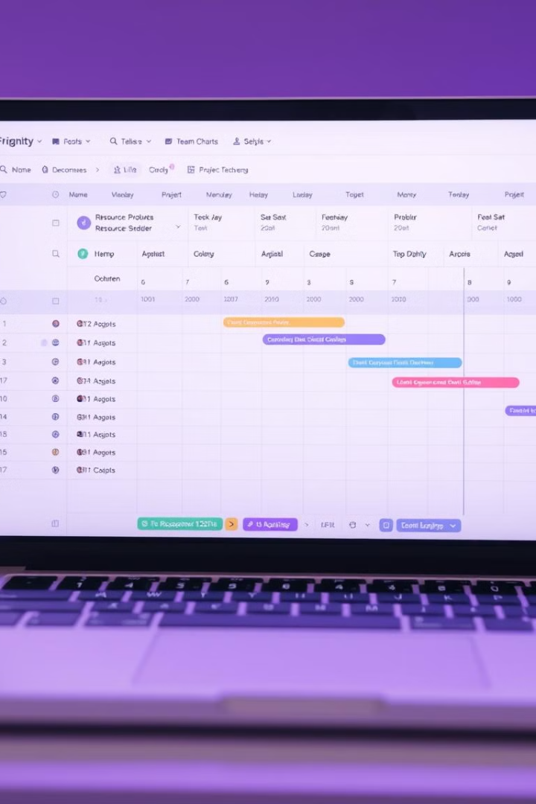



Real-Time Visualization & Metrics
Gantt Chart
Color-Coded
Key Metrics
Animation shows process execution in real-time.
Easy process identification with color-coded processes.
Average waiting time, turnaround time, and CPU utilization.

Slide 7

Demo: Live Simulation
Application Interface
Display Metrics
Show the application interface and process input.
Display Gantt chart and performance metrics clearly. Adjust process parameters to observe changes.
Simulations
Simulate FCFS.
Simulate SJF (Non-Preemptive and Preemptive).

Slide 8

Conclusion
Effective Tool
Simplifies Algorithms
The CPU Scheduler Visualizer is an effective learning tool.
It simplifies understanding complex algorithms with ease.
User-Friendly
Interactive, user-friendly, and customizable for all users.
Future Enhancements: Add more algorithms such as Priority and Round Robin.

Slide 9
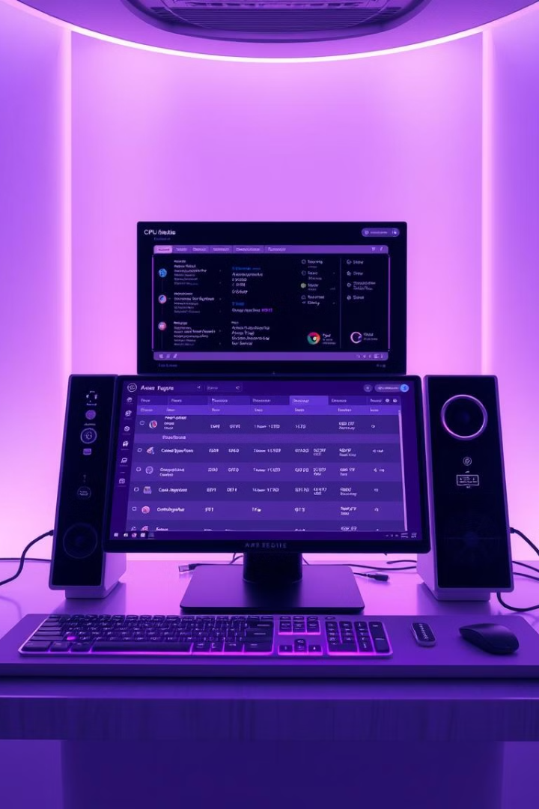
Objectives and Applications
The primary objective is to provide a tool for CPU scheduling.
It helps students to visualize complex scheduling algorithms.
Professionals can use it to understand the impact of algorithms.
Education
Research
Classroom learning for better understanding.
Analyze different scheduling algorithms.
Development
Optimize real-time operating systems.

Slide 10
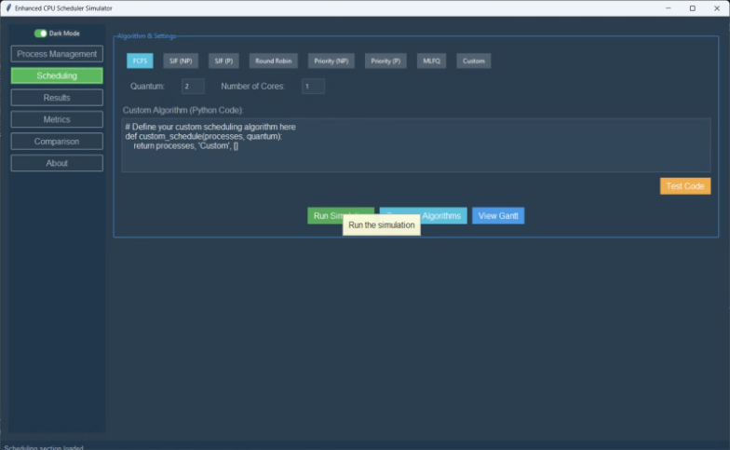
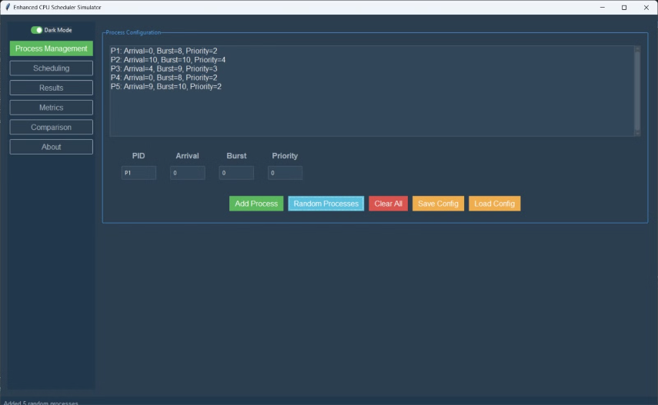

Slide 11
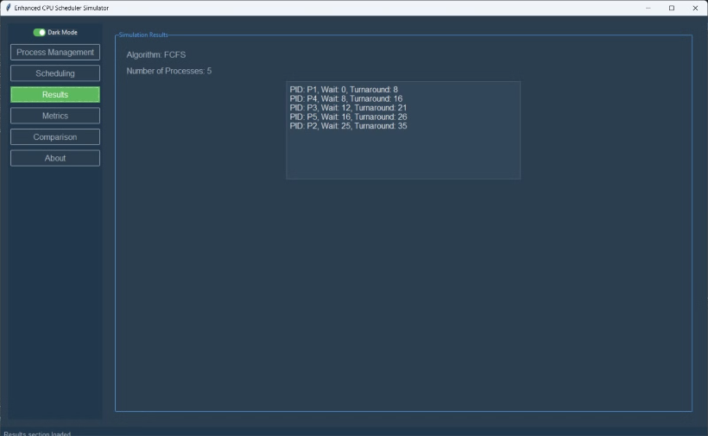
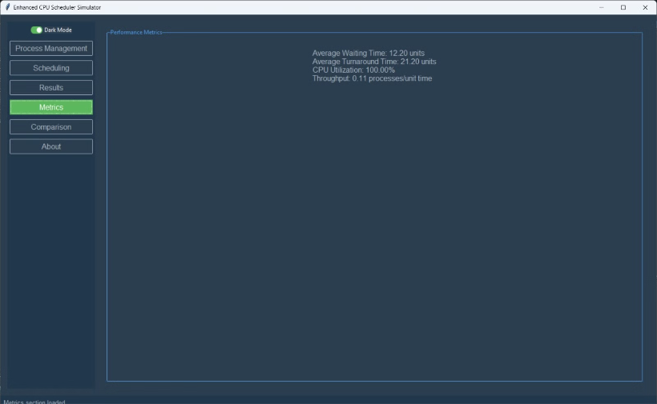

Slide 12
